Slide 1

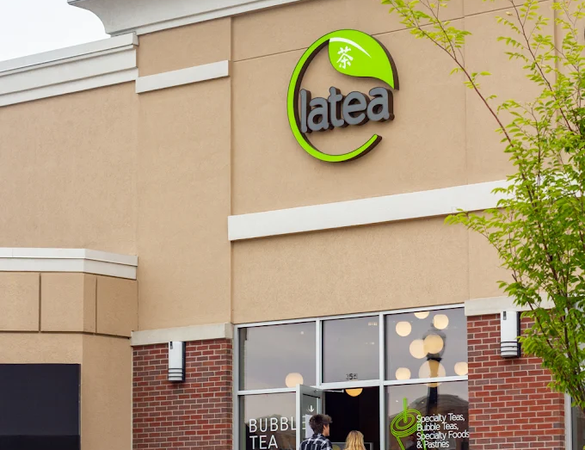

MGMT 5285: Consumer Behavior & Marketing
Brewing Connections:
A/B Testing Persuasion Strategies
Group #14

Slide 2

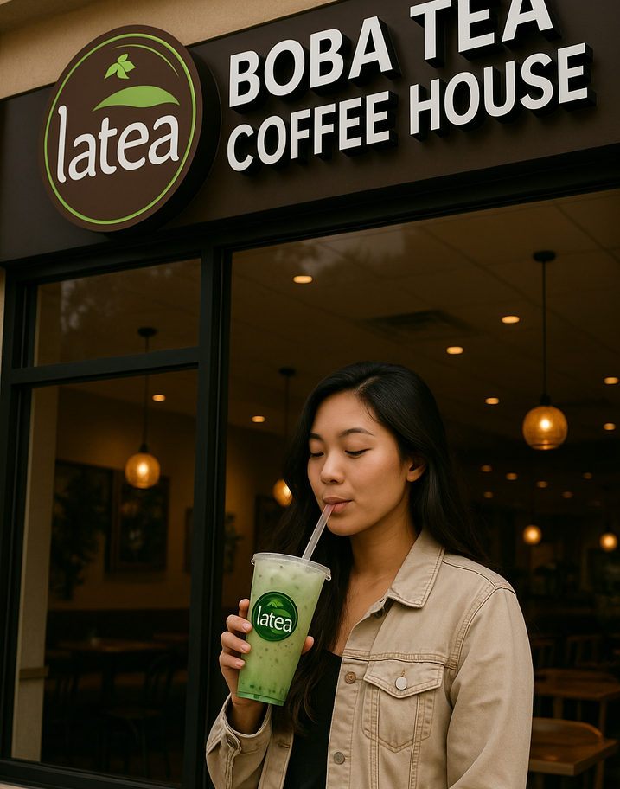




OVERVIEW
Latea Bubble Tea and Coffee, founded in 2013 by Jack Hsiao, offers premium, customizable tea and coffee drinks using organic, whole-leaf teas and fresh ingredients. With four U.S. locations, it emphasizes quality, authenticity, and a playful, community-driven experience that reflects modern consumer preferences.
Established | Branches | Customizations | Market Growth
Founded in 2013
4 U.S. Branches
10+ Options
USD 1.47B by 2030

Slide 3
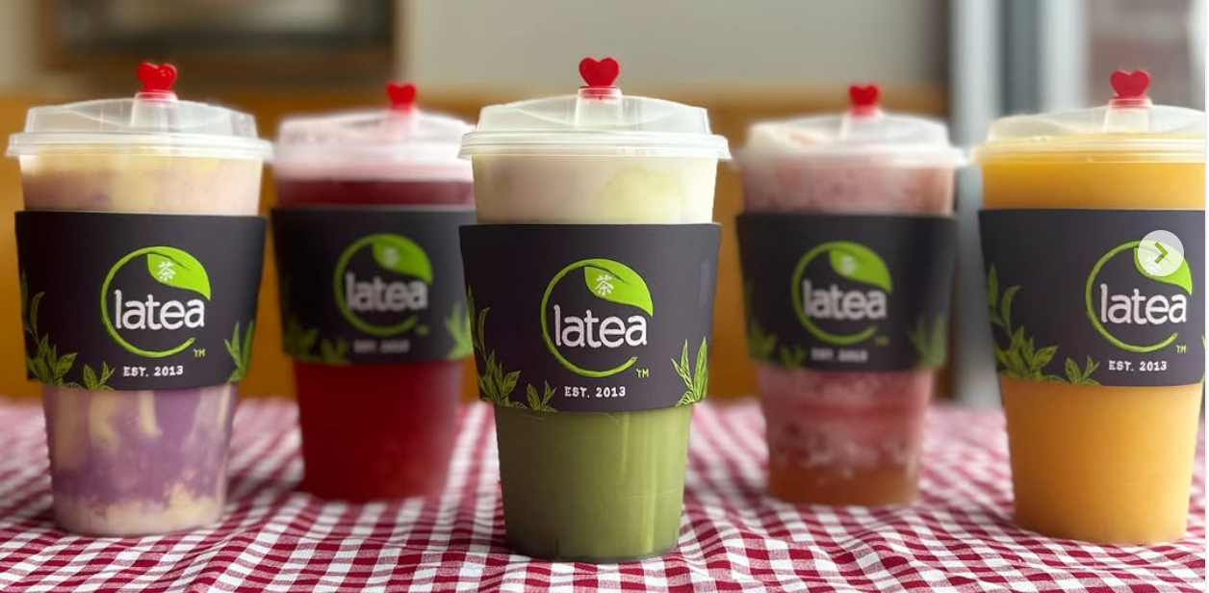






CAMPAIGN GOALS
(STRATEGIC ROADMAP)
Methodology
Compared two Instagram ad types: one focused on product quality (central route) and the other on emotional/social appeal (peripheral route).
Objective
Determine which ad strategy — emotional storytelling or product customization — most effectively drives engagement among Latea’s core audience using a controlled A/B test on Instagram.
Success Metrics
Reach, post interactions, website traffic, and profile visits were monitored to gauge campaign performance.

Slide 4




TARGET MARKET SEGMENTATION
(Target Audience Analysis)
Demographic
Pschycographic
Age - 18–34, college students and early career professionals.
Gender - Both genders, slight female skew.
Ethnicity - Diverse, including Asian American, Hispanic/Latinx, and African American.
Trend Sensitivity - Open to new trends and "Instagrammable" items.
Customization Oriented - Enjoy personalizing drinks to suit preferences and health needs.
Health Conscious - Prefer healthier, natural ingredient options.
Target
Segments
Geographic
Behavioral
West Lafayette, IN
Champaign, IL
Culver City, CA
Lone Tree, CO
Socially Connected - Share bubble tea experiences on social media, creating organic buzz.

Slide 5
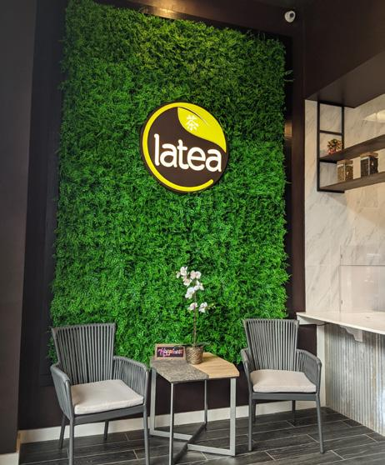
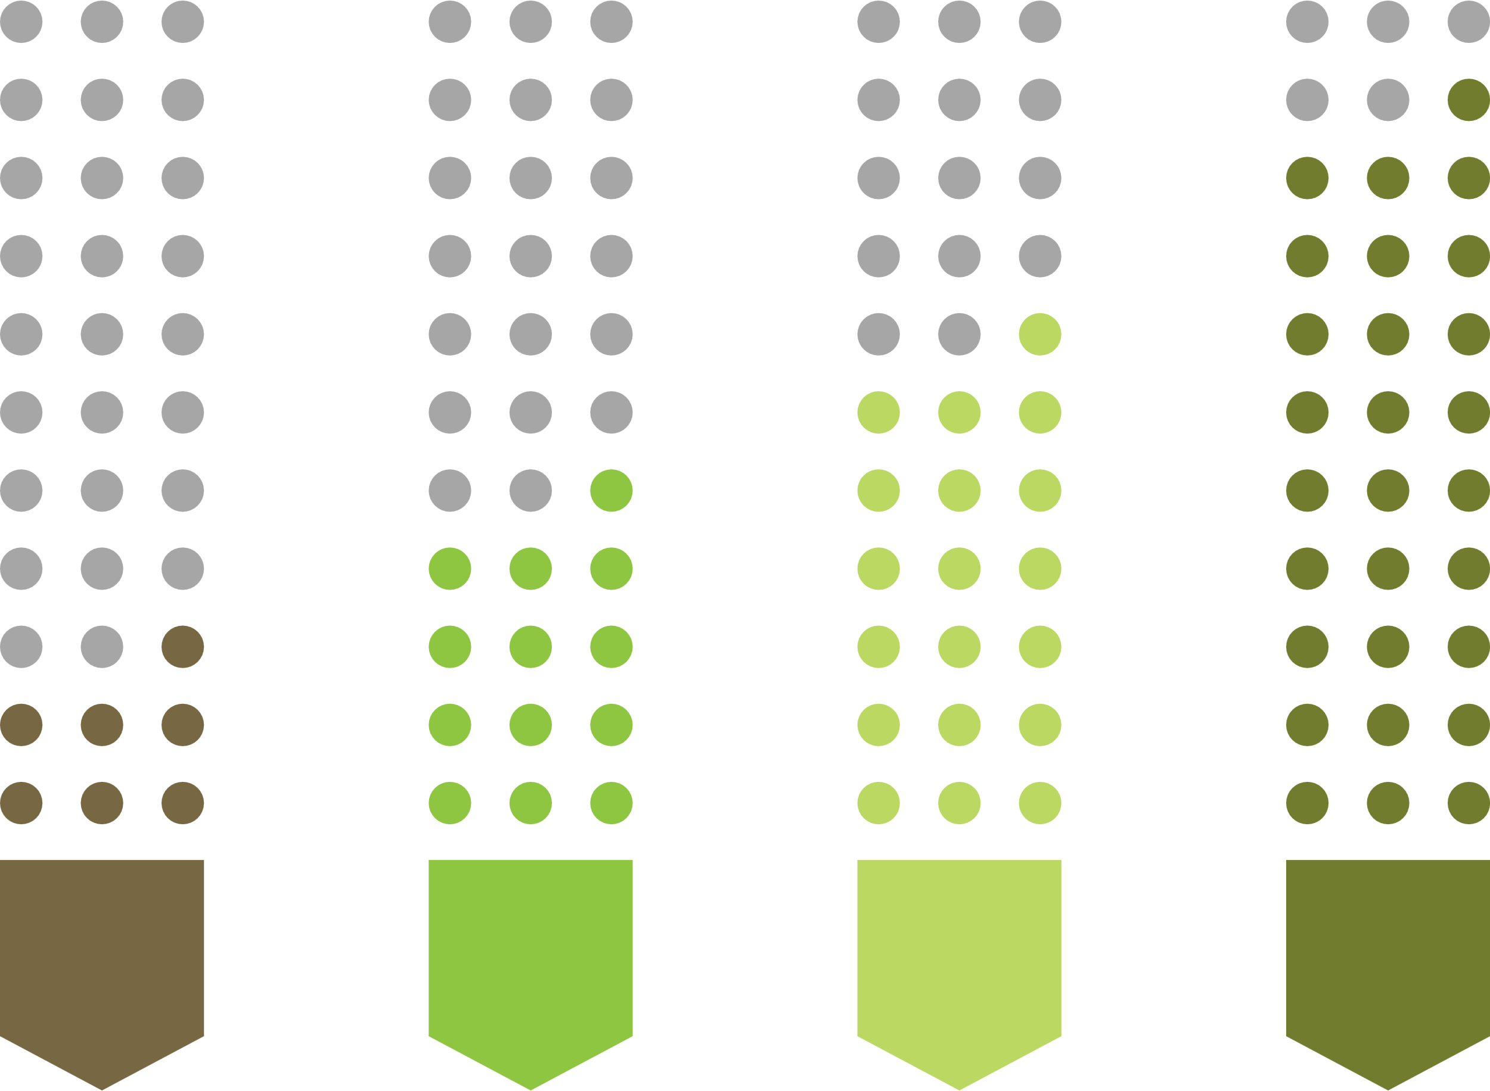
TARGET MARKET SEGMENTATION
(Target Audience Analysis)
Geographic
Behavioral
Demograhic
Phsychographic
[Magnitude and Relative Importance of each segmentation]

Slide 6
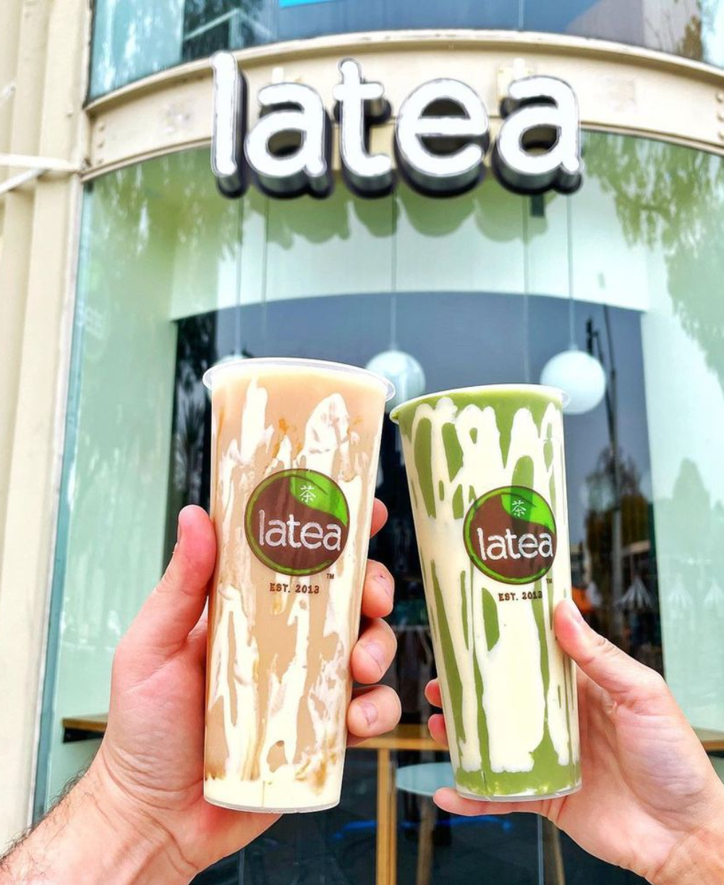




CONCEPTS AND HYPOTHESIS
(Applying Consumer Behavior Frameworks)
AD #1: CENTRAL ROUTE
AD #2: PERIPHERAL ROUTE
Based on Elaboration Likelihood Model (ELM) – Central Path: Appeals through logic, product info
Reinforces Self-Image Congruence: Aligns with consumers’ self-expression
Leverages ELM – Peripheral Path: Emotional, affective appeal
Uses Reference Group Influence: Friends enjoying Latea = social proof
Hypothesis: Ad 2 will outperform Ad 1 in social media engagement due to its emotional and social resonance
Notes:
“So to guide our ad strategies, we leaned on the Elaboration Likelihood Model, or ELM.
It basically says people process messages through two paths: either logically — the central route — or emotionally — the peripheral route.”
“Ad 1 used the central route, appealing to logic and product details like ingredient quality and customization.
Ad 2 took the peripheral route, focusing on emotional visuals and social bonding.”
“We also tied in theories like self-image congruence for Ad 1 — where customizing your drink reflects your personality —
and reference group influence in Ad 2 — where people are more likely to try something if they see friends enjoying it.”
“Our hypothesis? We expected Ad 2 to generate more engagement, especially on a platform like Instagram where quick, emotional appeal really matters.”

Slide 7
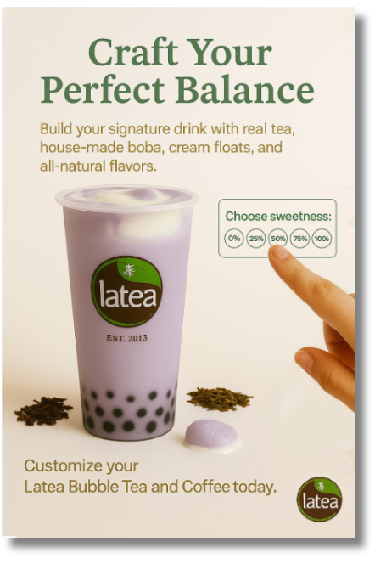







ADVERTISEMENT #1
(Central Route Persuasion)
HEADLINE
ELM
(CENTRAL)
“Craft Your Perfect Balance” highlights personalization and quality.
Uses detailed, rational messaging for thoughtful decision-makers.
DESIGN
CUSTOMIZATION
SELF IMAGE CONGRUENCE
Minimalist visual with focus on premium ingredients and customization.
Offers choice in sweetness levels and add-ons like boba and cream float.
Aligns product with consumers’ desire for authenticity and individuality.
Notes:
We featured a clean photo of Latea’s taro bubble tea, paired with visuals of real ingredients like cream float and tea leaves.”
“The tagline, ‘Craft Your Perfect Balance,’ emphasizes customization — viewers were encouraged to choose their own sugar level and add-ons.”
“This ad was perfect for someone who wants control over what they’re ordering — very rational, very detailed.
But that also means it relied on the audience taking time to read and process — which doesn’t always match fast-paced social media behavior.”

Slide 8
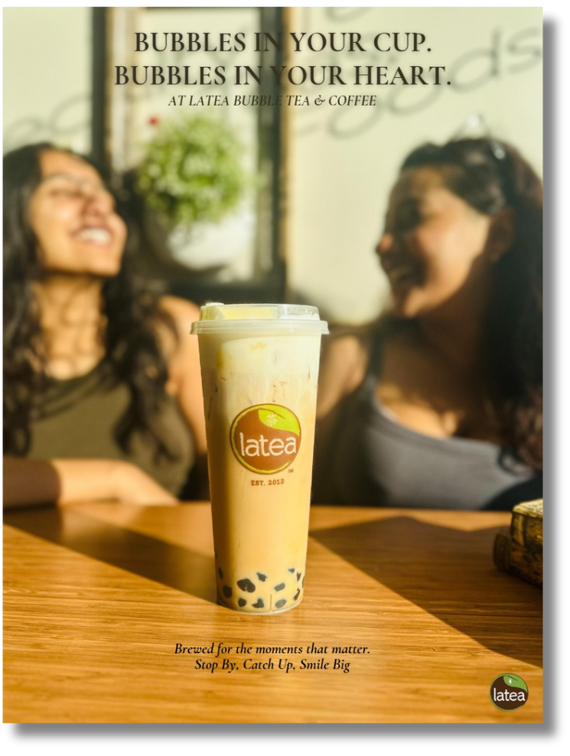
ADVERTISEMENT #2
(Peripheral Route Persuasion)
TAGLINE
ELM
(PERIPHERAL)
“Bubbles in Your Cup. Bubbles in Your Heart.” emphasizes emotional and social moments.
Relies on emotional cues and social imagery to create positive brand associations.
DESIGN
REFERENCE GROUP INFLUENCE
HYPOTHESIS
Warm, lifestyle image showing friends enjoying Latea, evoking connection.
Portrays peer interaction to encourage social identification and belonging.
Peripheral ad will drive higher engagement due to emotional appeal and social proof on platforms like Instagram.
Notes:
“Ad 2 took a totally different approach.
Instead of focusing on the product, it focused on the experience of drinking Latea.”
“We showed a warm, sunny moment — friends enjoying tea together.
The headline, ‘Bubbles in Your Cup. Bubbles in Your Heart,’ and the follow-up line, ‘Stop By. Catch Up. Smile Big,’ really set the tone.”
“This ad tapped into emotional cues — happiness, connection, lifestyle.
And it worked well on Instagram, where users often scroll quickly and respond more to vibe than details.”
“The use of peer imagery also added social proof, signaling that this is a drink to share — not just to sip.
And that’s where it stood out.”

Slide 9



CAMPAIGN PROCEDURE
(Strategy Walkthrough)
Campaign Duration | Platform and Format | Budget Allocation | Planned Target Strategy | Advertisment Scheduling | Key Matrics and Evaluation
Ran Sunday 11 PM to Tuesday 12 AM Captured both weekend & weekday activity | Instagram Feed + Stories Static image ads with targeted hashtags | $100 total, $50 per ad Even split for fair A/B test | 5–10 mile radius around 4 store cities Ages 16–35, English-speaking Interests: boba, college life, foodie culture | No time limits or edits Continuous, unbiased run | Views, reach, likes, shares, saves Website/profile visits, link taps, cost per visit
Notes:
“We designed two Instagram ads based on consumer behavior theory, specifically the Elaboration Likelihood Model. One ad used the central route, focusing on product quality and customization—its tagline was “Craft Your Perfect Balance.” The second ad used the peripheral route, tapping into emotional and social appeal with the tagline “Bubbles in Your Cup. Bubbles in Your Heart.”
To ensure a fair test, we allocated a $100 budget evenly—$50 for each ad—and targeted audiences aged 16 to 35 within a 5–10 mile radius of Latea’s four store locations. Both ads ran from Sunday night to Tuesday without any edits or time limitations, and we used static images across Instagram feeds and stories. The goal was to evaluate which ad style better resonated with our audience in terms of reach, engagement, and conversion metrics.

Slide 10
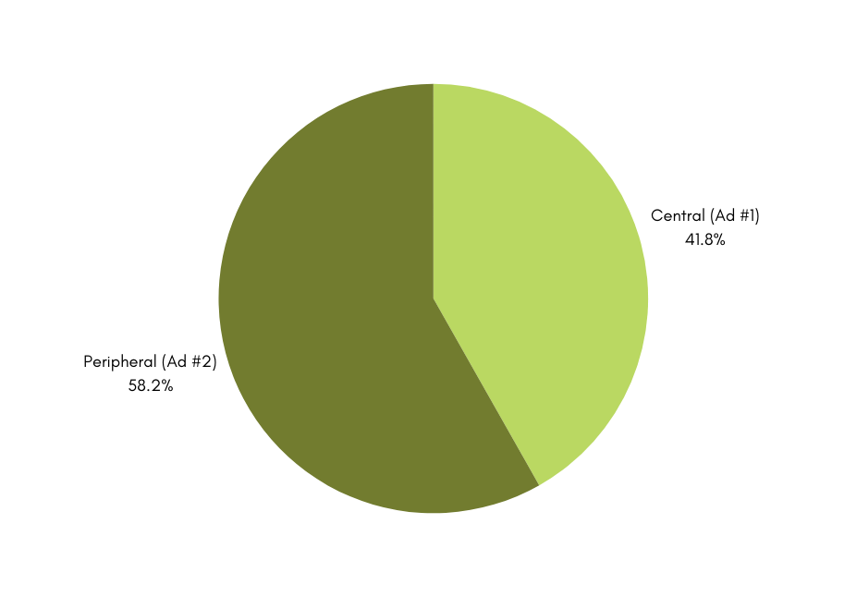
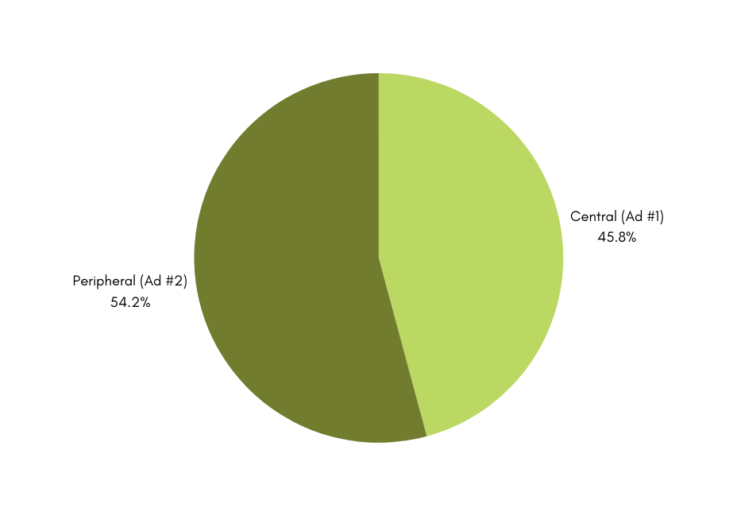
CAMPAIGN RESULTS
(Metrics Evaluation)
Post Interaction
Profile Activity
Notes:
The central route ad had slightly higher total views and reach—about 21,700 views versus 20,300, and 18,400 reach versus 15,400. However, the peripheral ad clearly outperformed in engagement and effectiveness. It saw 18% more post interactions, 29% more website visits, and had a 22% lower cost per website visit—$0.62 compared to $0.79 for the central ad.

Slide 11
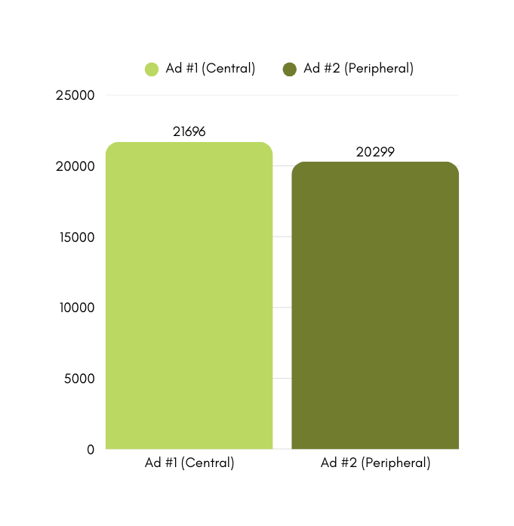
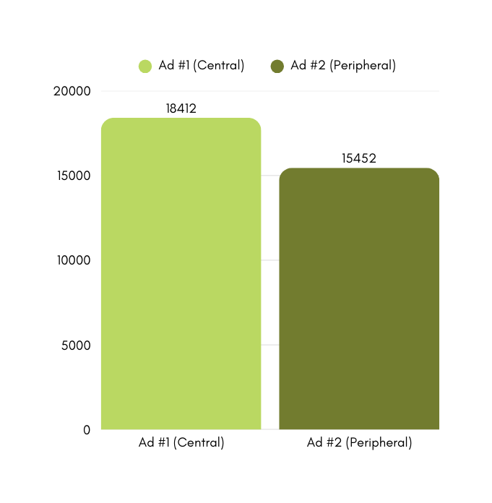
CAMPAIGN RESULTS
(Metrics Evaluation)
Total Views
Reach Overview

Slide 12
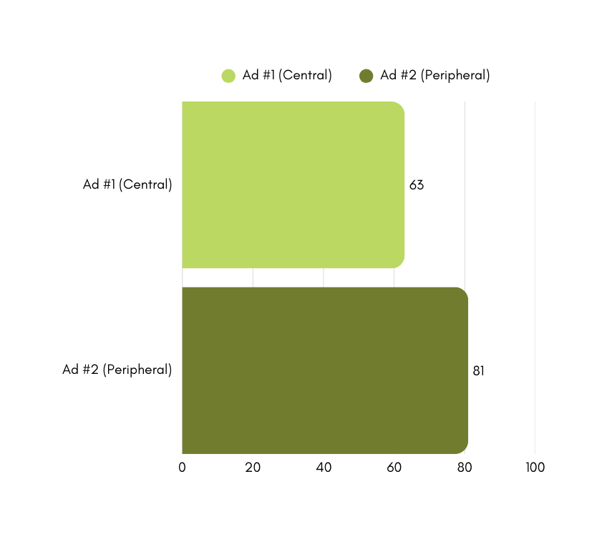
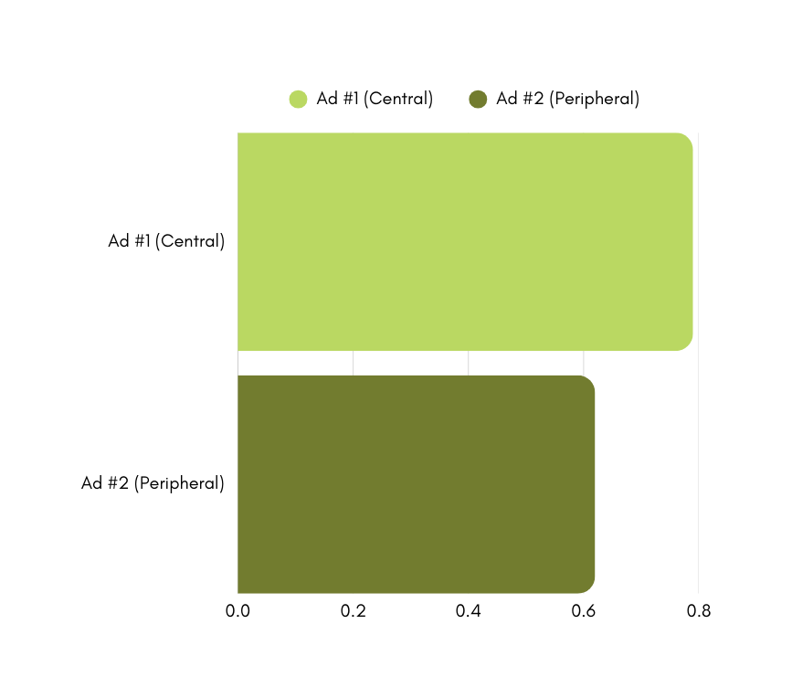
CAMPAIGN RESULTS
(Metrics Evaluation)
Website Visits by Ad Type
Cost Efficiency per Visit
Notes:
This confirmed our hypothesis: emotional and social messaging drives stronger action on platforms like Instagram, where users respond more to lifestyle and peer-based content. Ultimately, the peripheral route ad proved to be a more efficient driver of engagement and conversions for Latea.

Slide 13
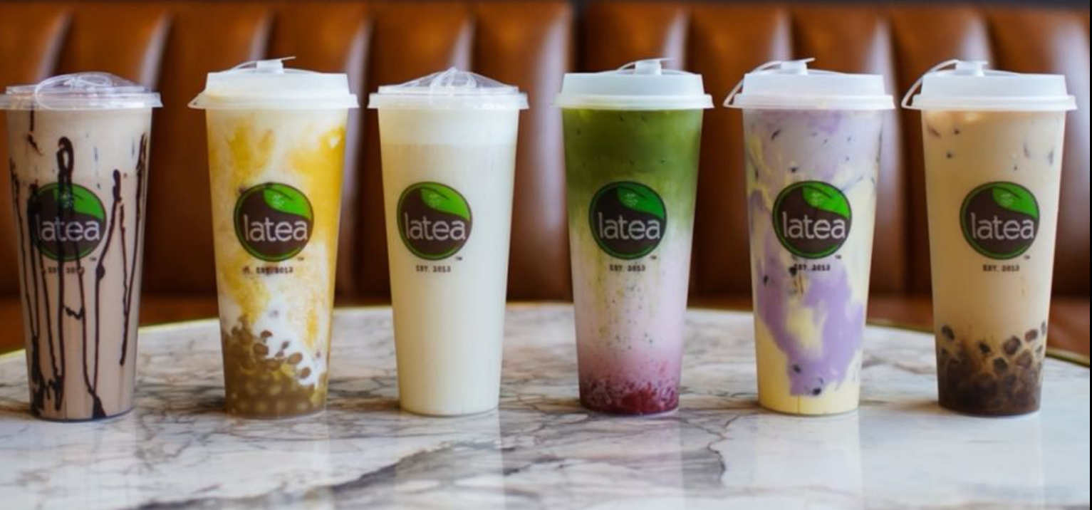
KEY TAKEAWAYS
(FOCUS POINTS)
18%
29%
22%
Higher Engagement
More Website Visits
Lower Cost
Peripheral route ad generated more profile activity.
Social-focused ad drove more traffic to Latea's website.
Cost per website visit was lower for the peripheral route ad.
(206 vs. 174)
(81 vs. 63)
($0.79 vs. $0.62)
Notes:
"Our A/B test showed that the peripheral ad—focused on emotion and social connection—performed better. It had 18% higher engagement (206 vs. 174), 29% more website visits (81 vs. 63), and was 22% more cost-effective per visit ($0.62 vs. $0.79). This proves that Latea’s audience responds more to emotional, relatable content over product details."

Slide 14





STRATEGIC RECOMMENDATIONS
(The Future Pathway)
Emotion
EMOTION
SHAREABILITY
Center ads on connection, warmth, and shared moments.
Use heartfelt taglines and lifestyle imagery.
Shareability
Design content that’s visually appealing and worth saving.
Encourage reposts and highlight user-generated content.
FUTURE
RECOMMENDATIONS
Platform
Maximize Reels and Stories for high engagement.
Use trending audio and short-form narratives.
BALANCE
PLATFORM
Reach
Use inclusive visuals to connect with diverse audiences.
Test across regions to identify top-performing locations.
Balance
Blend emotional appeal with soft product prompts.
Show customization subtly through engaging visuals.
REACH
Notes:
"Based on that, we recommend ads that focus on emotion and shared moments, with visuals worth reposting. Use Instagram Reels and trending sounds to boost engagement, and ensure diverse representation to expand reach. Finally, combine emotion with subtle product cues to maintain Latea’s brand balance."

Slide 15
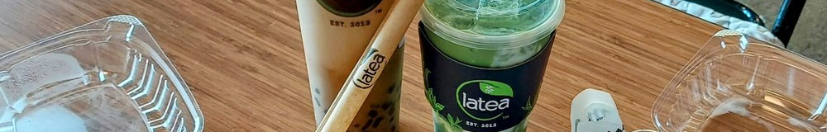
THANK YOU
Questions?

